Slide 1
<A non negative matrix factorization for collaborative filtering recommender systems based on a Bayesian probabilistic model>
Antonio Hernando
Jesús Bobadilla
Fernando Ortega
Universidad Politécnica de Madrid,Carretera de Valenciakm7,28031Madrid,Spain
Publish on <Knowledge-Based Systems > 2016
Reporter： 马晨 ma chen in Tsinghua university

Slide 2
Propostion 1
If the recommender system predicts that a user will like the item i, then there are some users with the same taste as u who have very positively rated item i
Factoring the rating matrix into 2 matrices:
1. related to items , 2 related to users.

Slide 3
CF recommend can be considered as filling missing matrix item（filling blank）

Slide 4
Two matrices, each have K latent components
We consider the existence of K latent factors explaining the ratings that users make.
For each user.
Bound to line in (0,1)

Slide 5
Latent factor explain
Groups of users who share the same tastes in our system.
: Propability of users belongs to group k.
: Propability of users in group k like item I
Reocmmend:

Slide 6
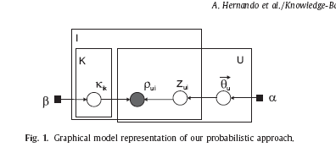
Method: Probabilitic Graphical Model
Input:
Ν: users in rating matrix
M: Number of items
:user u rating score to item i, which will be normailize

Slide 7
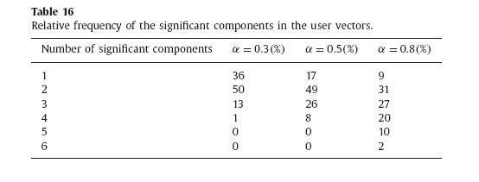
Model parameter
K: the user group number K
α :the possibility of obtaining overlapping groups of users sharing the same taste. Close to 0 means user tend to belong only 1 group. Also can be interpreted as sparsity of user vectors.
Table 16 shows in different alpha setting, how many user drop in these group .

Slide 8

Model parameter
β：the amount of evidence the algorithm requires to deduce that group of users will like item i.
With the increase of β , the system will predict more and more score 3 (indifference)
Rating score like flipping a coin with R times!

Slide 9
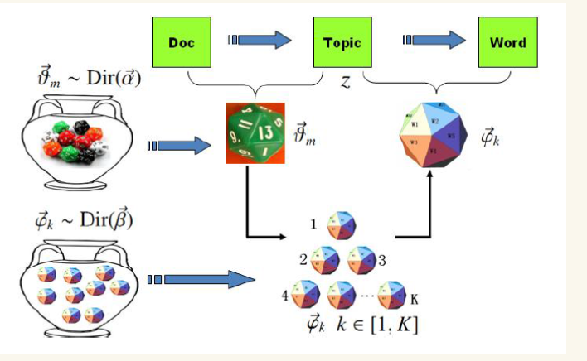
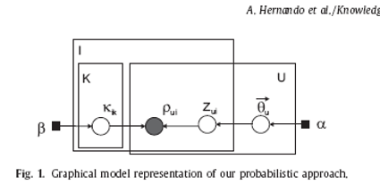

1， 这个过程表示在生成第u个人的小组概率分布的时候，先从第一个坛子中抽中一个user-group骰子 ，然后投掷这枚骰子生成了该用户中第i个物品的所属小组编号z_u,i。[注释]此为Dirichlet- Multinomial共轭。
2 这个过程表述了如下动作生成第u个用户的第i个物品：在手头的K个group-item硬币中，挑选编号为k=z_u,i的那个硬币进行投掷，一共R级评分，做R次实验，每次实验成功概率 ，然后生成物品评分。[注释]此为Beta- Binomial共轭。
$$κ_{i,z_{u,i}}$$

Slide 10
Why beta-binomial
0.the rating score is discrete, binomial is discrete distribution
1.using multinomial distribute does not take into account the order of rating scores.
2.plausibly model. A user evaluate R features of the item, the rating indicate the number of features user like.( user pick from R feature)
3. only one unknown parameter in this distribution, the probability that the user likes a feature of the item. Reduce overfitting.
4. beta distribution takes value within [0,1],which is confidence(prior knowledge) user will like or not.

Slide 11

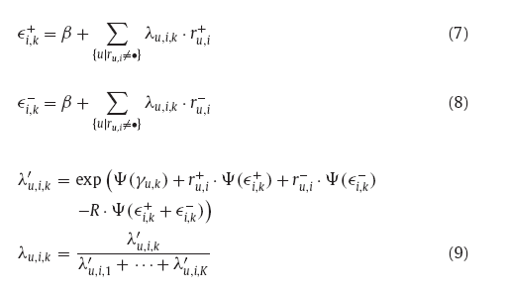
Algorithm: Iterater update equation
Varational parameter γ,

Slide 12
More explanation
: the probability that a user u belongs to group k
: the probability that users in group k likes item i

Slide 13
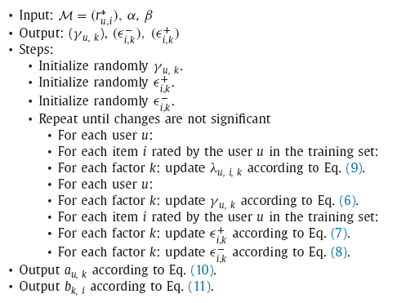

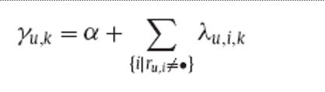
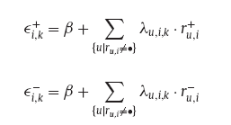


Slide 14
Input: rating matrix

Slide 15
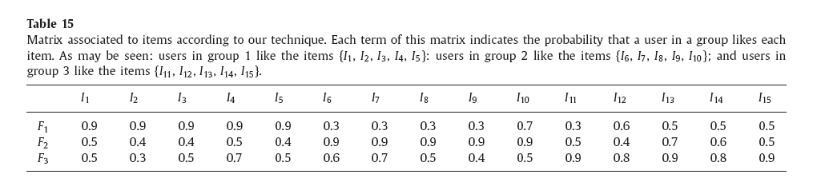
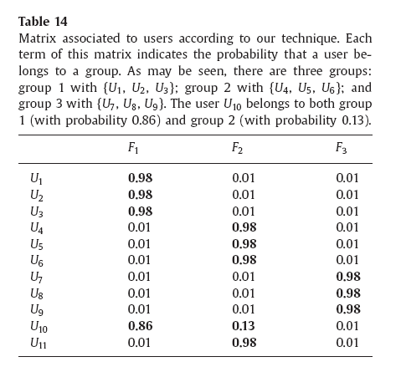
output

Slide 16
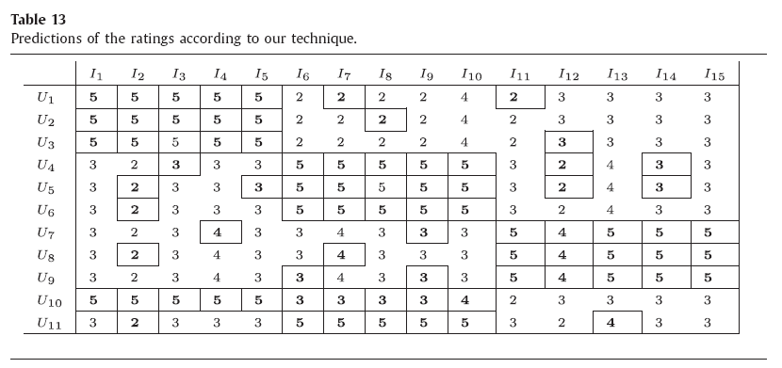
Final predict score

Slide 17
Compared with other technique: classical matrix factorization [5]R.Salakhutdinov,A.Mnih,Probabilistic matrix factorization,Adv.NeuralInf.Process.Syst.20(NIPS07)(2008)1257–1264. [6]Y.Koren,R.Bell,C.Volinsky,Matrix factorization techniques for recommender systems,Computer42(8)(2009)30–37. does not fulfill proposition 1

Slide 18
<non-negative matrix factorization> tend to predict low rating score

Slide 19
Unrelated items are 3 in order to minimize the average error

Slide 20
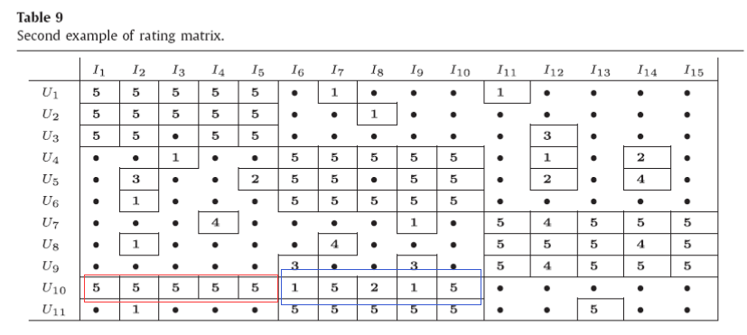
Example II: input rating matrix

Slide 21
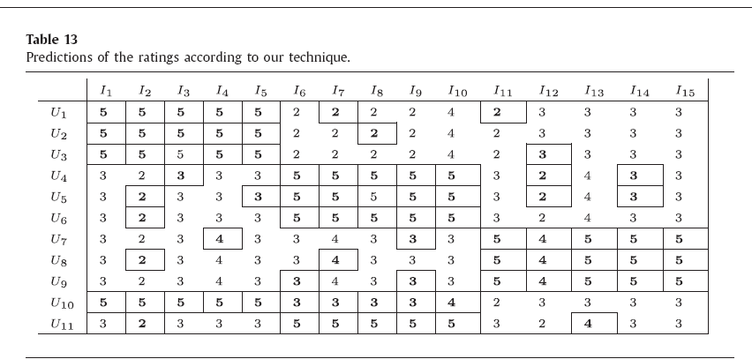
Example II: Prediction result

Slide 22
Example II:output User matrix

Slide 23
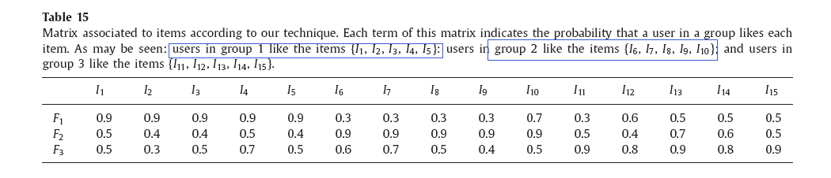
Example II: output Matrix associated to items

Slide 24
Evaluation 1: accuracy in prediction(score准确度)
1. accuracy: Mean Absolute Error
2. accuracy: Constrained Mean Absolute Error：

Slide 25
Evaluation 1: 0-1 Loss
Where

Slide 26
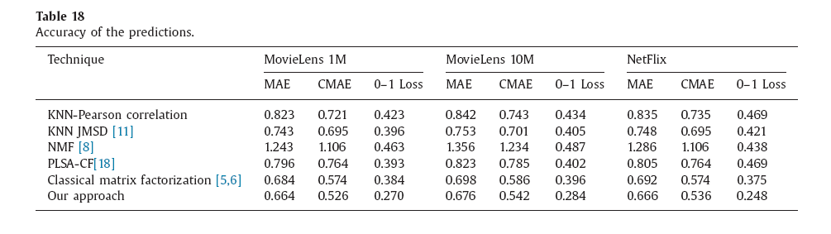
Evaluation 1: experiment result

Slide 27
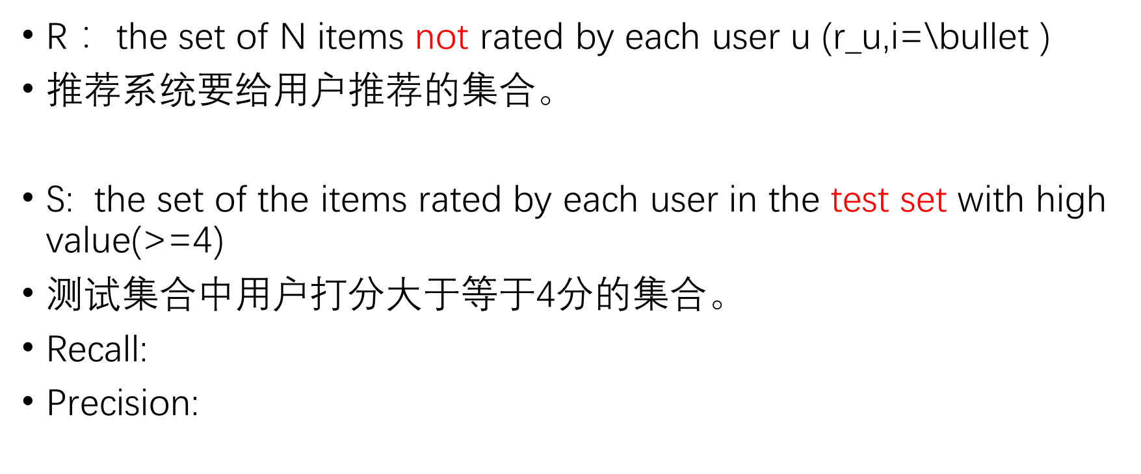
Evaluation 2: Accuracy in recommendation
R： the set of N items not rated by each user u ($\text{r}\text{_}\text{u}\text{,}\text{i}\text{=\backslash }\text{bullet}$ )
推荐系统要给用户推荐的集合。
S: the set of the items rated by each user in the test set with high value(>=4)
测试集合中用户打分大于等于4分的集合。
Recall:
Precision:

Slide 28
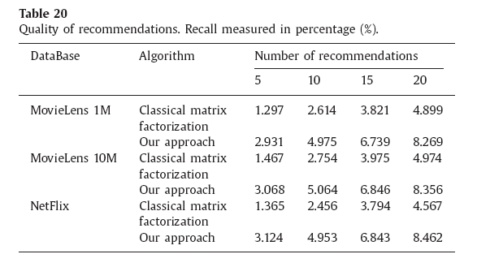
Evaluation 2 : Recall

Slide 29
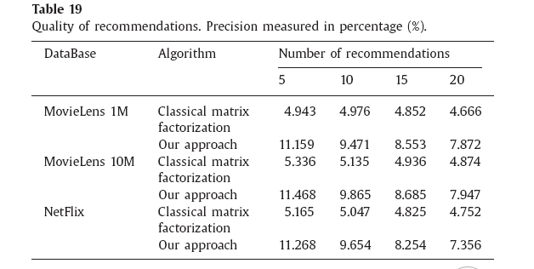
Evaluation 2 : Precision

Slide 30
Conclusion
We think that this improvement is due to the fact that this technique tends to predict indifference (value 3) those rating for which the algorithm has not found enough evidence

Slide 31
Summary（problem）
1. 存在的问题：没有考虑电影类别等其他相关数据
2. 仍然无法解决冷启动问题（cold start）
3. 这个模型的K不好设置。类似Topic Model的主题数不好定
4. 这个模型即会学出来一些比较好的组，也会学出来很多不太好的用户组（也就是说很多用户其实不相关也会被分为一组，或者该组喜好没有一个明显的趋势，比如说恐怖片fans等属于高质量组，但是也会有很杂乱喜好的人群聚到一个组。
5. 这个模型仍然会训练出虽然是不同的用户组，但是其实是兴趣很相似的。

Slide 32
Summary（Good part）
2.学习了变分推断法做概率图模型设计的新的思路和数学技巧
3.填补矩阵缺失元素的方法可以用在其他领域。

